Slide 1

Project on

Slide 2
Project Details Name- Pushpa Naik Enrollment No- project details- Automation and manual project on Flipkart(open url, search, add to cart, search flights) using selenium by testNG.

Slide 3
Title – Flipkart shopping experience Subtitle- Test execution by using selenium with testNG –open url, search product, Add to cart, search flights.

Slide 4
Table content
Introduction to Application
Module1- Home Page
Module2 – My Account
* Login
Module3- Order the Products
* Search
*Display products
*Search for flights
*Select the products and add to cart

Slide 5
Project Document(Flipkart)
Flipkart application is a sample e commerce website . It offers a range of fashion, food, grocery, beauty, home & decor, electronics, health, Automotive.
The user can search ,view details and finally can order the product needed.
https://www.flipkart.com/

Slide 6
Objectives Faster Test Execution: The primary objective is to speed up the testing process by executing multiple test cases or test suites simultaneously. This helps in reducing the total test execution time, providing faster feedback to the development team. * Scalability: Parallel testing is scalable, which means it can handle an increasing number of test cases or test data without a linear increase in execution time. * Improved Test Coverage: By executing different test cases concurrently, parallel testing helps achieve better test coverage. It ensures that a wide range of scenarios and conditions are tested. * Cost-Efficiency: Parallel test execution optimizes resource usage, which can lead to cost savings in terms of infrastructure and reduced testing time. * Early Bug Detection: Faster test execution allows for the early detection of bugs and issues, enabling quicker bug fixes and reducing the cost of addressing defects later in the development cycle.

Slide 7
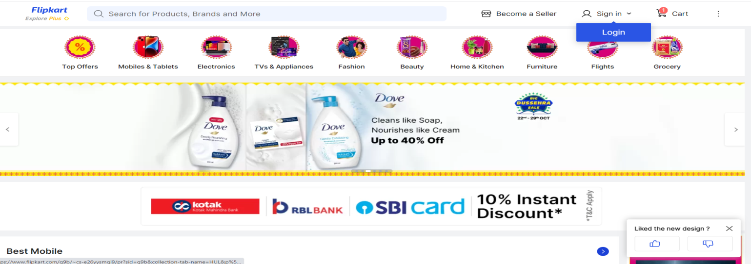
Module 1 – Home Page
To validate that the URL and the page title of an application is correct.
To validate all the main menus/information are present on the home page(https://www.flipkart.com/).

Slide 8
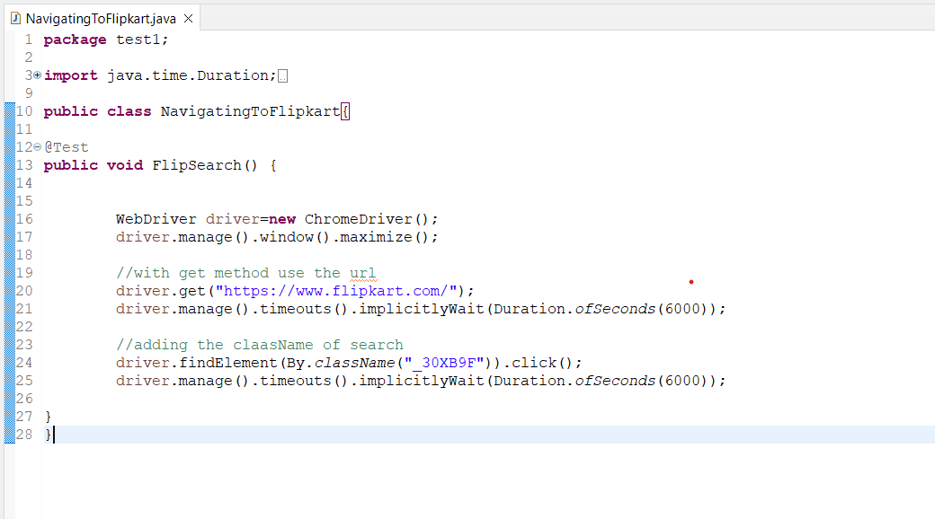

Slide 9
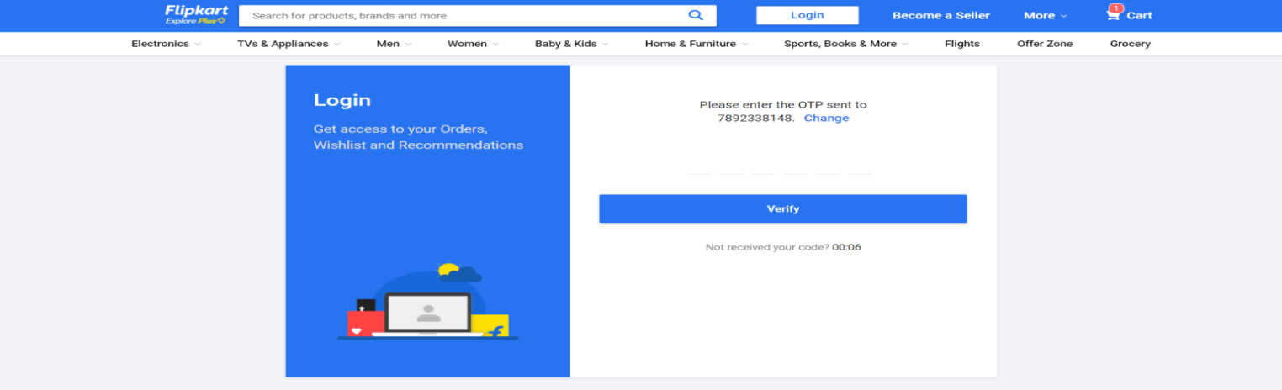
Login:
User will login with the application by using the credentials created while sign up.
To validate the login page with all options.
To validate Sign up Link.
To validate Forgot Password Link

Slide 10
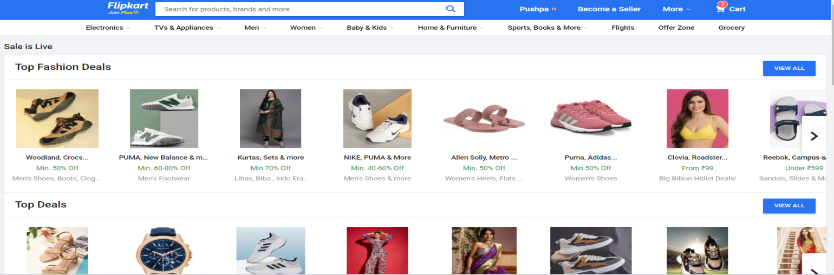
Module 2 – Ordering the product Search:
To validate all the fields with all validation for search functionality.
To validate it display relevant information on selecting/deselecting the options from the catalog.

Slide 11
Searching of product 1.Initialize WebDriver: Inside the test method, initialize the WebDriver. This could be done by specifying which browser Chrome and providing the path to the browser driver executable ChromeDriver 2.Navigate to Flipkart: Use the get method to navigate to the Flipkart website by providing its URL. 3.Locate the Search Box:Use Selenium's findElement method to locate the search input field on the Flipkart website. You can use various locators like By.id 4..Enter Search Query:Use the sendKeys method to enter the search query (shoes Sneakers for Men) into the search input field. 5..Submit the Search: Use the submit method on the search input field element to initiate the search. Alternatively, you can locate the search button and click on it. 6.Assertion: After submitting the search, you can assert that the search results page has loaded successfully. You can check for specific elements on the search results page to ensure that the search was successful. 7.Close WebDriver: Finally, close the WebDriver instance to clean up resources.

Slide 12
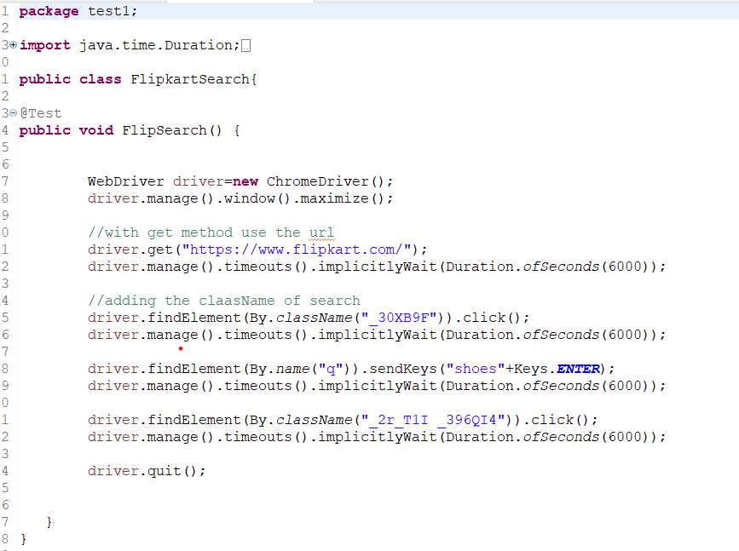

Slide 13
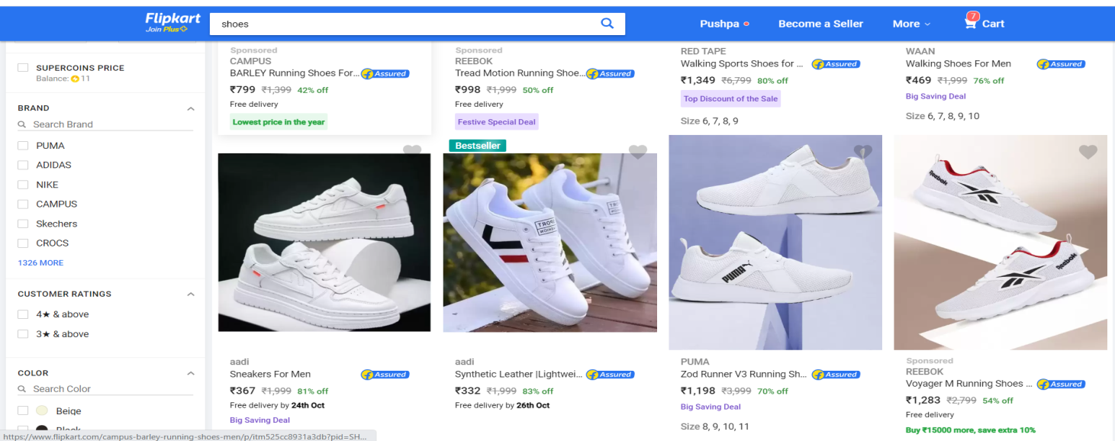
Display Products: User:
will search the product based on some order with respect to cost, product name reference.
Validate the products are displayed.
Validate the products are sorted based on the selection.

Slide 14
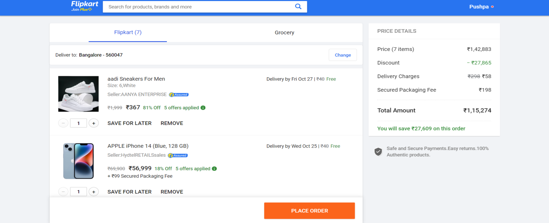
Select the Product and Add to Cart:
The user selects the product desired and checks it to the cart and click on proceed to checkout.
Validate the user can select the product and add it to cart.
Validate the selection of multiple products and all being visible in the cart.
Validate the flow when the user clicks on proceed to checkout.

Slide 15
Addtocart It would launch the Chrome browser and maximize the window. 2) Navigate to the Flipkart website and perform the Login operation. 3) Now, it’ll search for the iphone keyword which we choose as < APPLE iPhone 14 (Blue, 128 GB) >. 4) In this step, the code will lead us to click to view the search results. 5) We’ll now fetch the list of iphone displayed and select the last one using the XPath locator. 6) Click on the iphone link to open the next page. Click on the book link to open the next page. 7) It’s time to click the <Add to Cart> button, but there are five of them displayed on the page. So, we used the below XPath to locate the first link to perform the add cart action.

Slide 16
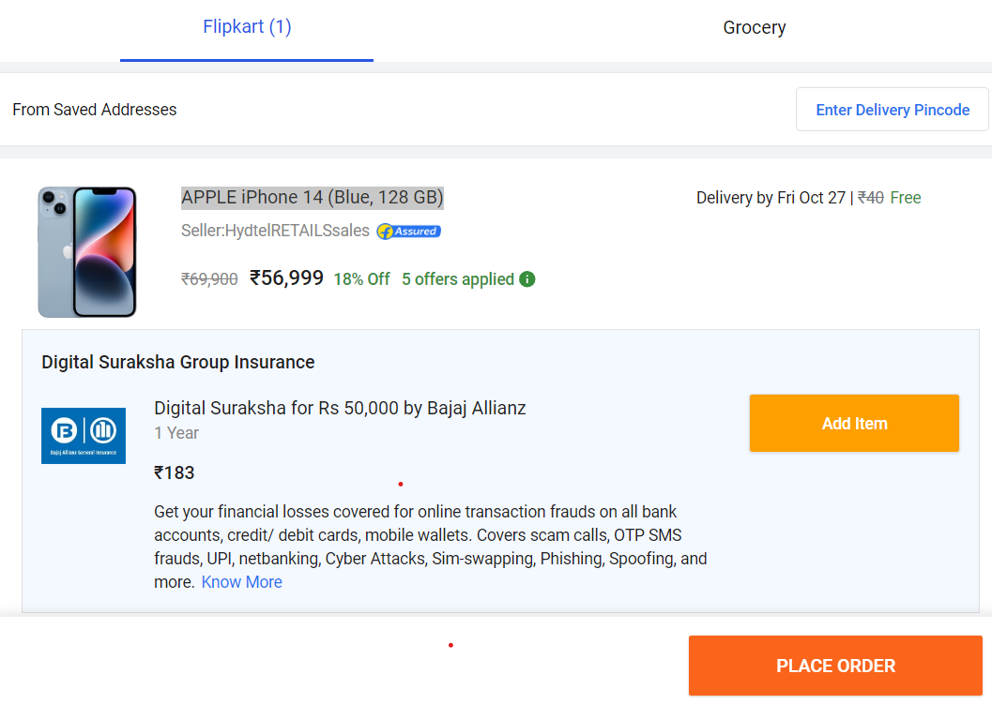
h
After add to cart option the browser opens in another page.
So we use WindowHandles as a child window(Heading of child window)
Using navigation to findElement we used the below XPath to locate the first link to perform the add cart action.
In the next few steps, we’ll view the cart, verify the iphone entry, and press continue to fill the email.

Slide 17
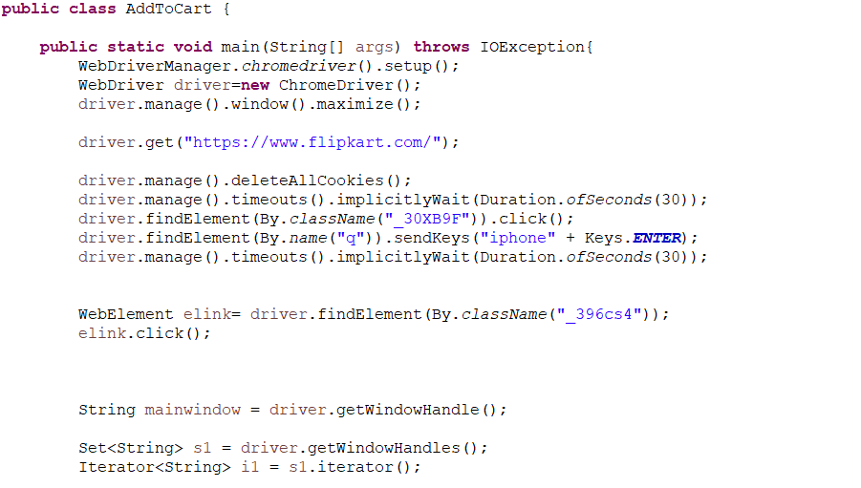
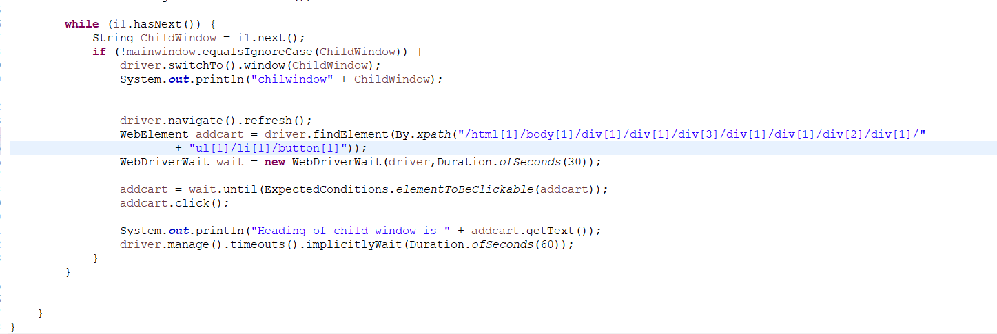

Slide 18
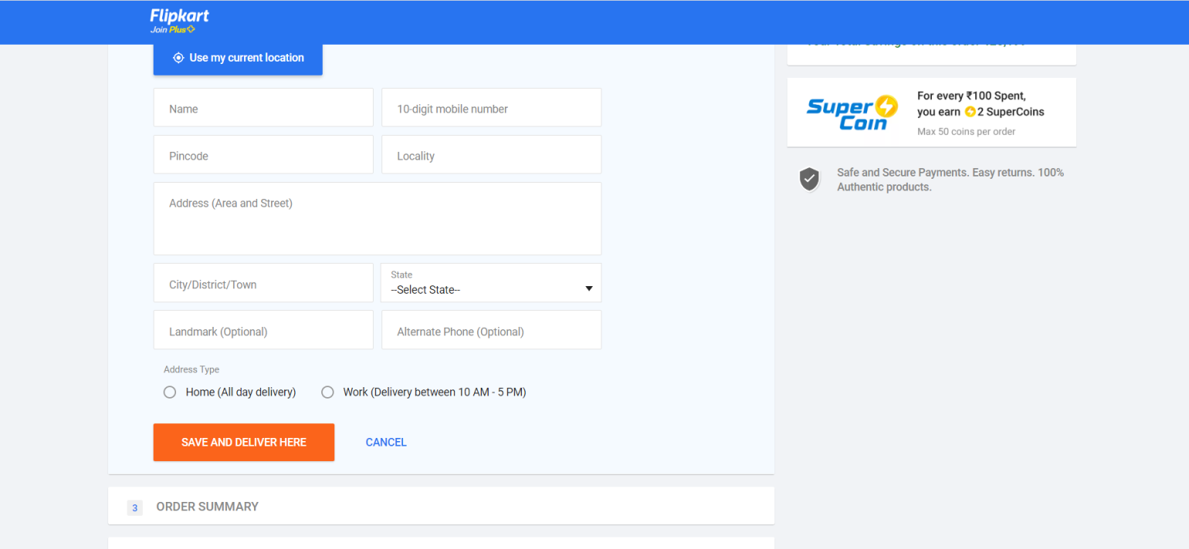
Place the Order:
The user proceeds to fill the shipping address details and makes the payment.
Validate all the fields of the address form.
Validate all the fields of the shipping page.
Validate all the fields of the payment page.

Slide 19
Search Flights 1.Initialize WebDriver: Inside the test method, initialize the WebDriver. This could be done by specifying which browser Chrome and providing the path to the browser driver executable ChromeDriver 2.Navigate to Flipkart: Use the get method to navigate to the Amazon website by providing its URL. 3.Locate the Search Box:Use Selenium's findElement method to locate the search input field on the Flipkartwebsite. You can use various locators like By.xpath 4.Enter Search Query:Use the sendKeys method to enter the search query into the search input field. 5. Add the city and click the button search. 6.Close WebDriver: Finally, close the WebDriver instance to clean up resources

Slide 20
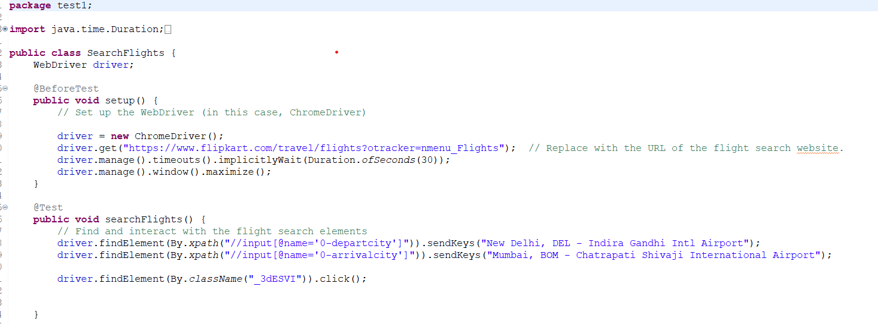

Slide 21
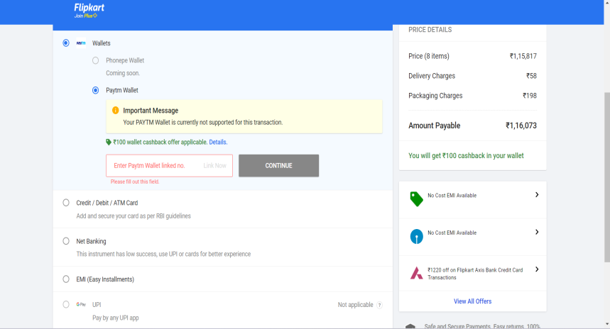
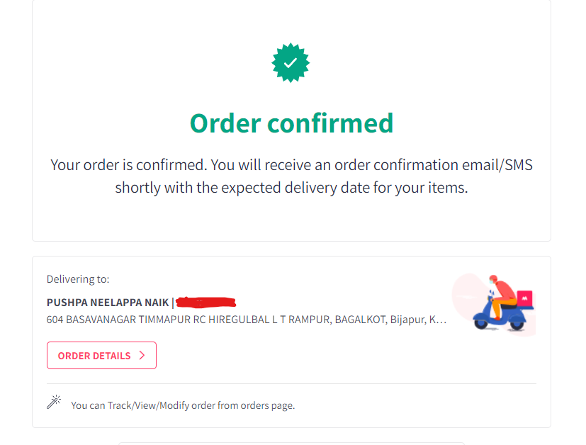
Module 4– Check Out
x
Step 1: Checkout options
Step 2: Billing details
Step 3: Delivery details
Step4: In Billing Details
Step 5: Payment method
Step 6: Confirm order

Slide 22
Conclusion Selenium is a Powerful Tool: Selenium is a robust and widely-used automation testing framework that can be employed to automate web interactions, making it an ideal choice for automating Amazon. Benefits of Automation: Automation offers numerous advantages, including improved accuracy, faster execution, and the reduction of manual effort, ultimately enhancing the user experience on Amazon. Test Environment Setup: A proper test environment setup is essential for Selenium automation, including installing necessary drivers and dependencies. Future Possibilities: The skills learned in this presentation can be extended to automate other aspects of Amazon shopping or applied to automate interactions on other websites.

Slide 23


